Slide 1
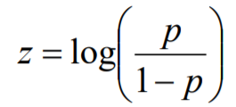

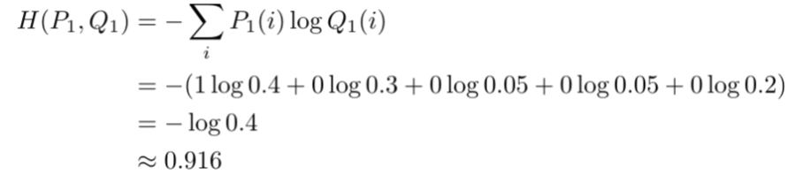


Input Layer
Weighted Connection
Hidden Layer
i1
w1
Logits
(-inf, inf)
h1
w’1
w2
Weighted Connection
Mapping probability
i1
w7
Odds
(0, inf)
Pi/(1-Pi)
w3
w8
w9
w’2
h2
w’’1
i1
h1
w'1
mapping
softmax
w4
w10
Activation
function
out
Probabilities
(0,1)
w13
w'2
Pi
w11
w14
w’’2
i1
w15
w’3
w'3
h2
w5
w12
h1
w16
w'4
mapping
i1
w17
w’4
w6
w18
b3
h1
Cross Entropy
(0,1)
i1
b2
b2
b1
b1
Calculate
Error
Loss function
b
b
Back Propagation
on errors
Mean Square Error

